Slide 1
First-Order Logic in Artificial intelligence

Slide 2
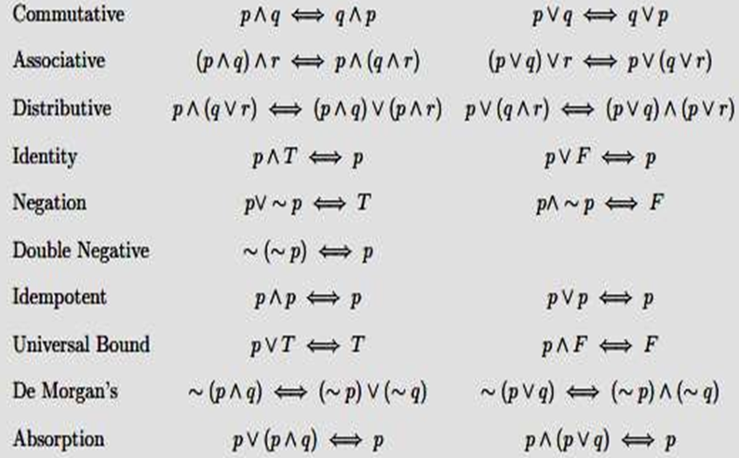
Inference rules:

Slide 3
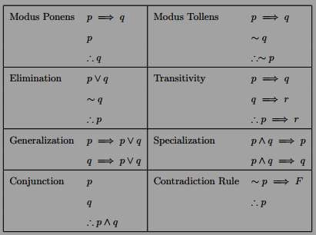

Slide 4
First-Order Logic in Artificial intelligence
PL is not sufficient to represent the complex sentences or natural language statements. The propositional logic has very limited expressive power. Consider the following sentence, which we cannot represent using PL logic.
"Some humans are intelligent", or
"Sachin likes cricket."
To represent the above statements, PL logic is not sufficient, so we required some more powerful logic, such as first-order logic.

Slide 5
FOL
First-order logic is another way of knowledge representation in artificial intelligence.
First-order logic is also known as Predicate logic or First-order predicate logic. First-order logic is a powerful language that develops information about the objects in a more easy way and can also express the relationship between those objects.
First-order logic (like natural language) does not only assume that the world contains facts like propositional logic but also assumes the following things in the world:
Objects: A, B, people, numbers, colors, wars, theories, squares, pits, wumpus, ......
Relations: It can be unary relation such as: red, round, is adjacent, or n-any relation such as: the sister of, brother of, has color, comes between
Function: Father of, best friend, third inning of, end of, ......
first-order logic also has two main parts:Syntax
Semantics

Slide 6
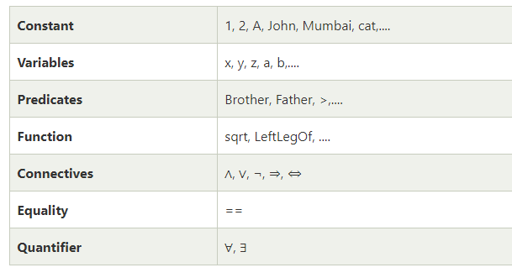
Syntax of First-Order logic:
Basic Elements of First-order logic:

Slide 7
Atomic sentences:
Atomic sentences are the most basic sentences of first-order logic. These sentences are formed from a predicate symbol followed by a parenthesis with a sequence of terms.
We can represent atomic sentences as Predicate (term1, term2, ......, term n).
Example: Ravi and Ajay are brothers: => Brothers(Ravi, Ajay).
Complex Sentences:
Complex sentences are made by combining atomic sentences using connectives.

Slide 8
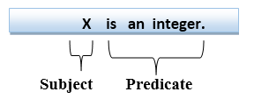
First-order logic statements can be divided into two parts:
Subject: Subject is the main part of the statement.
Predicate: A predicate can be defined as a relation, which binds two atoms together in a statement.
2. Marcus was a Pompeian.
Pompeian(Marcus)
1. Marcus was a man.
man(Marcus)

Slide 9
Quantifiers in First-order logic:
A quantifier is a language element which generates quantification, and quantification specifies the quantity of specimen in the universe of discourse.
These are the symbols that permit to determine or identify the range and scope of the variable in the logical expression. There are two types of quantifier:
Universal Quantifier, (for all, everyone, everything)
Existential quantifier, (for some, at least one).

Slide 10



Universal quantifier (∀)
∀x: means “for all” x
It is used to represent phrase “ for all”.
It says that something is true for all possible values of a variable.
In universal quantifier we use implication "→".
Ex. “ John loves everyone”
∀x: loves(John , x)

Slide 11
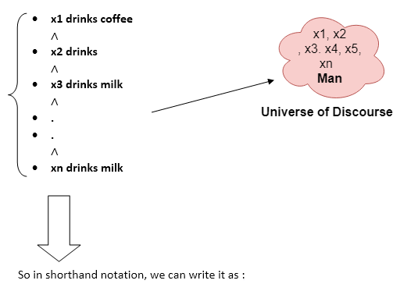
All man drink milk.
∀x man(x) → drink (x, milk).

Slide 12
Existential quantifiers
Existential quantifiers are the type of quantifiers, which express that the statement within its scope is true for at least one instance of something.
It is denoted by the logical operator ∃, which resembles as inverted E.
In Existential quantifier we always use AND or Conjunction symbol (∧).
“some people like reading and hence they gain good knowledge”
∃ x: {[person(x) ∧ like (x , reading)] ->gain(x, knowledge) }

Slide 13
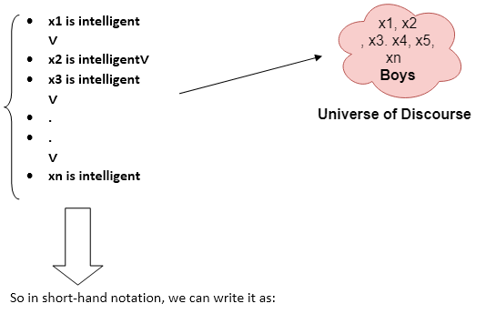
Some boys are intelligent.
∃x: boys(x) ∧ intelligent(x)

Slide 14
EXAMPLES
All birds fly. "fly(bird).“
Every man respects his parent. "respect(x, y)," where x=man, and y= parent.
Some boys play cricket. "play(x, y)," where x= boys, and y= game.
Not all students like both Mathematics and Science. "like(x, y)," where x= student, and y= subject.

Slide 15
EXAMPLES
All birds fly. "fly(bird).“ ∀x bird(x) →fly(x).
Every man respects his parent. "respect(x, y)," where x=man, and y= parent. ∀x man(x) → respects (x, parent).
Some boys play cricket. "play(x, y)," where x= boys, and y= game. ∃x boys(x) → play(x, cricket).
Not all students like both Mathematics and Science. "like(x, y)," where x= student, and y= subject. ¬∀ (x) [ student(x) → like(x, Mathematics) ∧ like(x, Science)].

Slide 16
We can use both ∀ and ∃ seperately
Ex: “ everybody loves somebody ”
∀x: ∃y: loves ( x , y)
Connection between ∀ and ∃
“ everyone dislikes garlic”
∀ x: ¬ like ( x , garlic )
This can be also said as:
“there does not exists someone who likes garlic”
¬ ∃x: like (x, garlic)

Slide 17
Quantifier Scope
Switching the order of universal quantifiers does not change the meaning:
(∀x)(∀y)P(x,y) ↔ (∀y)(∀x) P(x,y)
Similarly, you can switch the order of existential quantifiers:
(∃x)(∃y)P(x,y) ↔ (∃y)(∃x) P(x,y)
Switching the order of universals and existentials does change meaning:
Everyone likes someone: (∀x)(∃y) likes(x,y)
Someone is liked by everyone: (∃y)(∀x) likes(x,y)

Slide 18
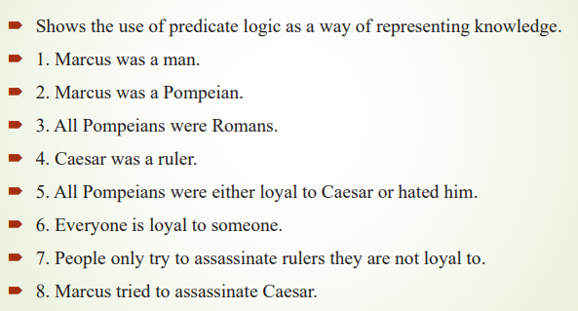

Slide 19
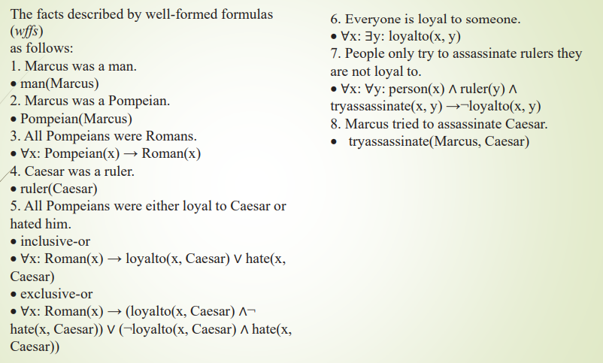

Slide 20
Connections between All and Exists
We can relate sentences involving ∀ and ∃ using De Morgan’s laws:
(∀x) ¬P(x) ↔ ¬(∃x) P(x)
¬(∀x) P ↔ (∃x) ¬P(x)
(∀x) P(x) ↔ ¬ (∃x) ¬P(x)
(∃x) P(x) ↔ ¬(∀x) ¬P(x)

Slide 21
Quantified inference rules
Universal instantiation
∀x P(x) ∴ P(A)
Universal generalization
P(A) ∧ P(B) … ∴ ∀x P(x)
Existential instantiation
∃x P(x) ∴P(F) ← skolem constant F
Existential generalization
P(A) ∴ ∃x P(x)

Slide 22
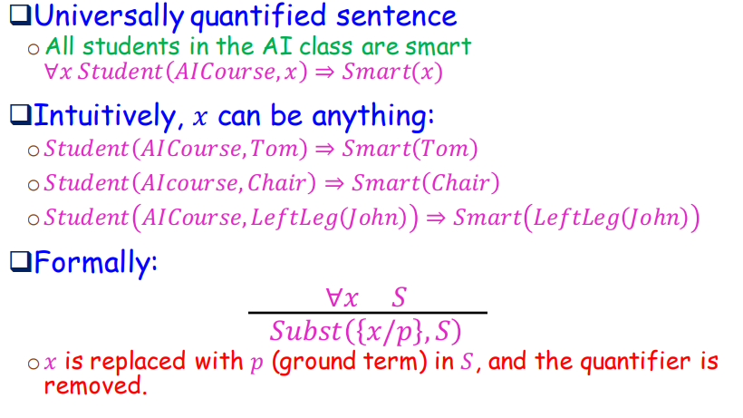
Universal instantiation (a.k.a. universal elimination)

Slide 23
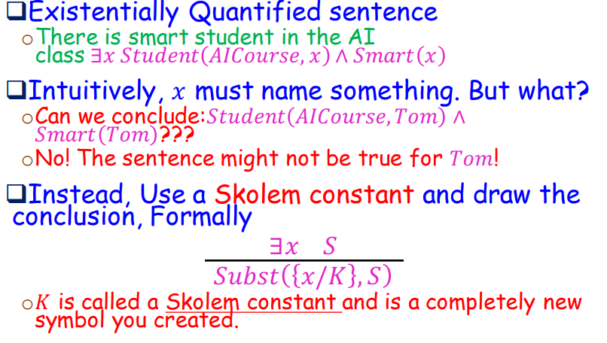
Existential instantiation (a.k.a. existential elimination)

Slide 24
Existential generalization (a.k.a. existential introduction)
If P(c) is true, then (∃x) P(x) is inferred.
Example: Let's say that, "Priyanka got good marks in English." "Therefore, someone got good marks in English."
All instances of the given constant symbol are replaced by the new variable symbol
Note that the variable symbol cannot already exist anywhere in the expression

Slide 25
Universal Generalization:
Universal generalization is a valid inference rule which states that if premise P(c) is true for any arbitrary element c in the universe of discourse, then we can have a conclusion as ∀ x P(x).
Example: Let's represent, P(c):
"A byte contains 8 bits", so for ∀ x P(x)
"All bytes contain 8 bits.",
it will also be true.

Slide 26
Translating English to FOL
Every gardener likes the sun.
You can fool some of the people all of the time.
You can fool all of the people some of the time.
All purple mushrooms are poisonous.
No purple mushroom is poisonous.
Clinton is not tall.

Slide 27
Translating English to FOL
Every gardener likes the sun.
∀x gardener(x) → likes(x,Sun)
You can fool some of the people all of the time.
∃x ∀t person(x) ∧time(t) → can-fool(x,t)
You can fool all of the people some of the time.
∀x (person(x) → ∃t (time(t) ∧can-fool(x,t)))
All purple mushrooms are poisonous.
∀x (mushroom(x) ∧ purple(x)) → poisonous(x)
No purple mushroom is poisonous.
∀x (mushroom(x) ∧ purple(x)) → ¬poisonous(x)
Clinton is not tall.
¬tall(Clinton)
Equivalent
Equivalent

Slide 28
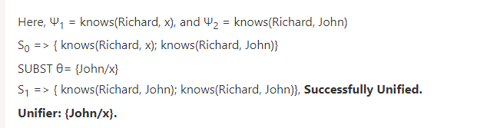
Unification
It’s a matching procedure that compares two literals and discovers whether there exists a set of substitutions that can make them identical.

Slide 29
Resolution
Resolution is used, if there are various statements are given, and we need to prove a conclusion of those statements. Unification is a key concept in proofs by resolutions. Resolution is a single inference rule which can efficiently operate on the conjunctive normal form or clausal form.
Clause: Disjunction of literals (an atomic sentence) is called a clause. It is also known as a unit clause.
Conjunctive Normal Form: A sentence represented as a conjunction of clauses is said to be conjunctive normal form or CNF.

Slide 30
Resolution algorithm
Conversion of facts into first-order logic.
Convert FOL statements into CNF
Negate the statement which needs to prove (proof by contradiction)
Draw resolution graph (unification).

Slide 31
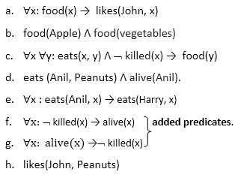
John likes all kind of food.
Apple and vegetable are food
Anything anyone eats and not killed is food.
Anil eats peanuts and still alive
Harry eats everything that Anil eats.
Prove by resolution that:
John likes peanuts.

Slide 32
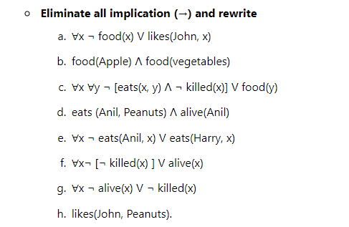
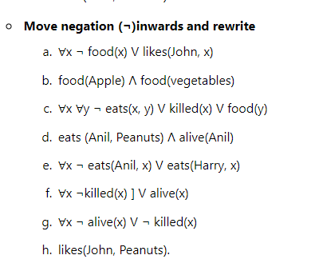

Slide 33
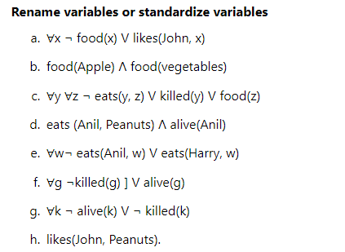

Slide 34
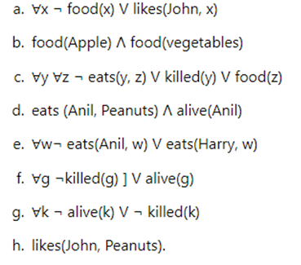
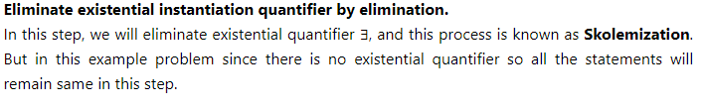
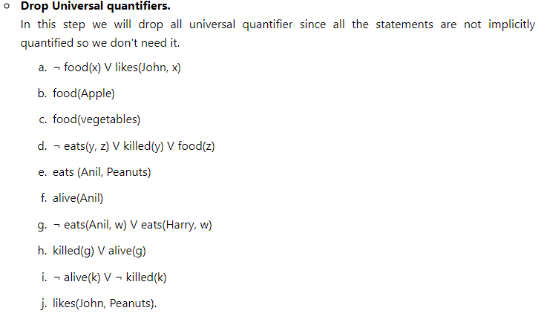

Slide 35
